Slide 1

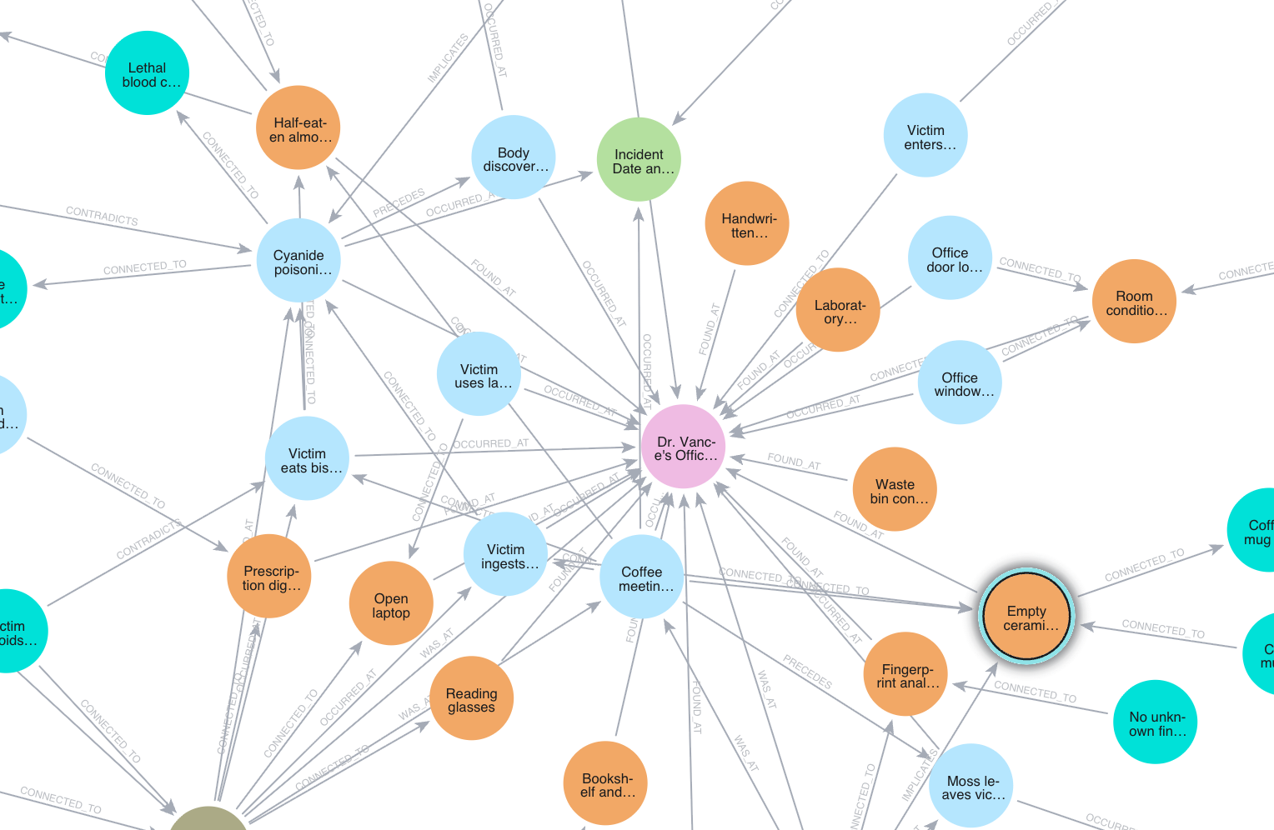

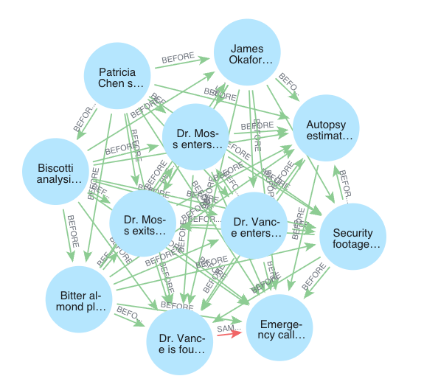
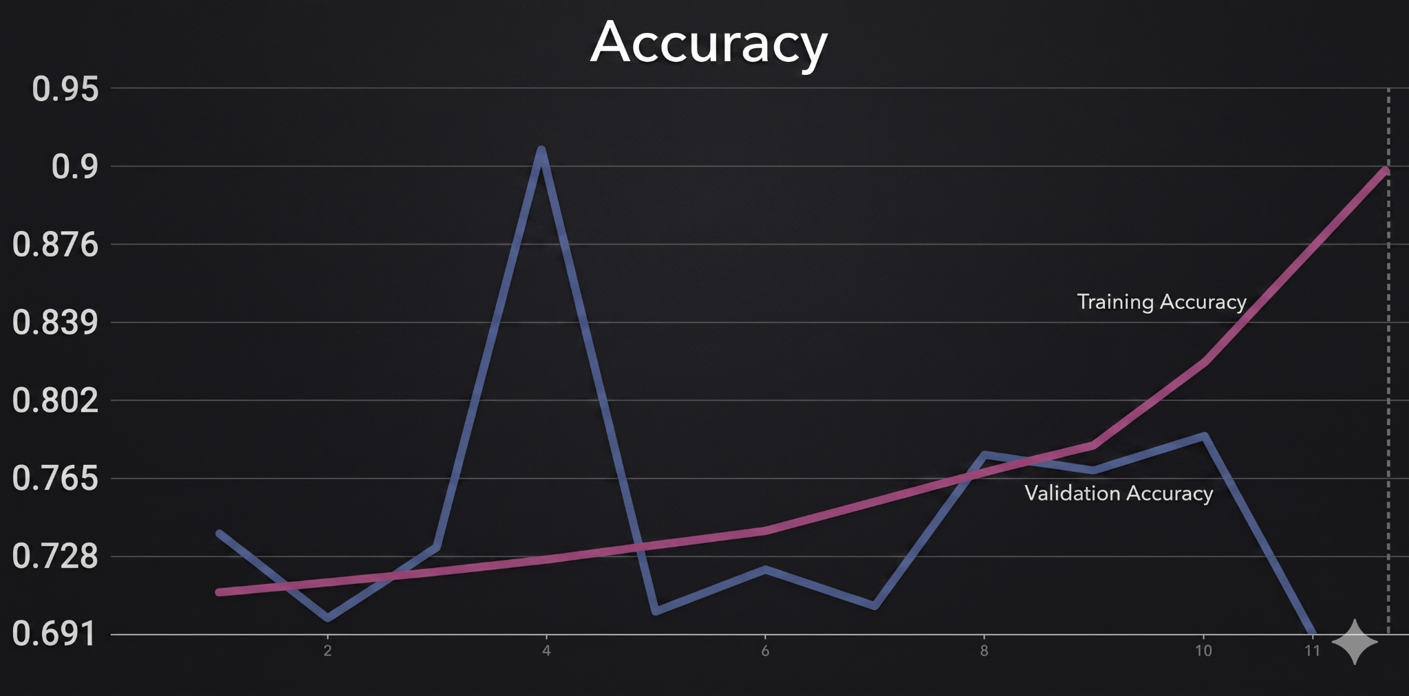
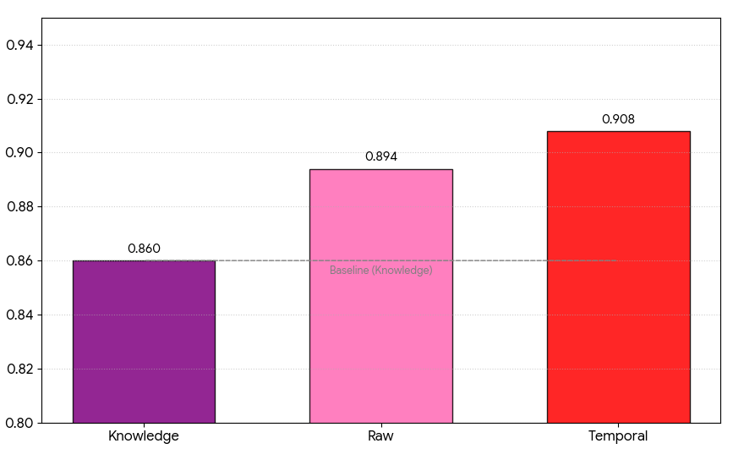
Modeling Crime-Solving with LLMs via Structured Knowledge Representations and Fine-Tuning
Viola Pande and Aditya Khandelwal | Gabor SysLab 2026
Introduction
Results
Large Language Models (LLMs) have demonstrated an impressive capability to process vast amounts of textual data. However, when confronted with complex, multi-layered problem-solving tasks — such as criminal investigations — the reasoning cap acity of a baseline LLM is often constrained by how information is contextualized. This study investigates how organizing data into different structures affects an LLM's capacity to critically reason through and solve crime cases. By mapping facts to knowledge and temporal graphs, this research evaluates whether explicit structural relational links can guide an agent toward more accurate anomaly detection and postulations.
Evaluation of the 24 test cases across the different knowledge structures yielded varying levels of accuracy. Supplementing the raw baseline LLM (which achieved a 79.2% accuracy rate) with a temporal graph increased accuracy to 81.3%, with a superior capacity to recognize temporal contradictions. The standalone knowledge graph achieved an accuracy of only 75.0%, struggling with making connections across longer timelines and multiple entities. In addition, the temporal graph configuration was generally the most confident, achieving an average confidence level of 90.8%, as opposed to the knowledge graph LLM (86.0%) and the raw LLM (89.4%). The combined graph only performed as well as its weakest component, earning an accuracy of 75.0%, as well. Both graphs struggled with the deeper, global synthesis required to spot hidden intent or deception. The fine-tuned gemini-2.5-flash model, however, demonstrated substantial improvements. It concluded training with an 81.2% accuracy rate and achieved a 90.0% accuracy on general testing. When applied directly to the 24 complex test cases, the fine-tuned model achieved an 89.6% accuracy rate accompanied by a high self-assessed confidence level of 91.0%, while maintaining a validation loss of 1.29 and a testing loss of 1.43.
Can AI bots solve crime?
Knowledge Graph
Entities: Person, Location, Evidence, Timestamp, Event, Alibi, Fact
Relationships: WAS_AT, FOUND_AT, IMPLICATES, OCCURRED_AT, PRECEDES, CONNECTED_TO, CONTRADICTS
Methods
This study utilized a dataset of 24 multidisciplinary crime scenarios accompanied by solution keys, either generated or synthesized by AI. For the baseline and experimental trials, an internal LLM extracted entities, timestamps, and evidence from raw case text, which were then mapped into Neo4j to generate JSON-formatted knowledge graphs (containing nodes like objects, locations, and facts) and temporal graphs (detailing events and timestamps). LLM agents were then prompted to critically solve the 24 test cases under four conditions: using the raw baseline text, the text with a temporal graph, the text with a knowledge graph, and finally, using both of the graphs together. Finally, the combined graph model was fine-tuned to better reason across the knowledge structures. For training purposes, the original repository was expanded to 80 cases and split into a 70/30 distribution for training and testing. A gemini-2.5-flash model was tuned on step-by-step reasoning chains detailing means, motive, opportunity, and timeline consistency, using 4 epochs and a learning rate multiplier of 1. Final outputs by each model consisted of a top suspect as well as a self-assessed confidence level by the model from 0 to 1.
Fine-tuned training and validation accuracy
Self-assessed confidence level by model
Conclusion
This research demonstrates that an AI system's reasoning performance is highly sensitive not just to the volume of information it receives, but to the structure that information is stored within. Additionally, time-based evidence seems to be more effective than ontological evidence in catalyzing multi-step problem-solving by large language models. Extensive graph representations can occasionally hinder global reasoning due to overfitting or complex indirect implications. Ultimately, combining the temporal and knowledge graphs, complete with fine-tuning, proved to be the most viable solution, yielding substantial gains in both accuracy and postulation confidence. Future work could expand beyond textual evidence and into photographic and videographic material, ultimately broadening both the scope and realism of this project.
Your goal is to solve the case. Use your knowledge to your advantage.
In your response, include at the very end your current postulation for who/what the culprit may be (name/title only),
a confidence level (0.0 to 1.0) indicating how sure you are about this theory.
Example format: Culprit_Name 0.75
Temporal Graph
Entities: Event, Person
Relationships: INVOLVED_IN, SAME_TIME_AS, BEFORE
Snippet of instructions prompted to LLMs

